Slide 1
International Student Centre
Kyle and Sandra
4th Year BSCN Students

Slide 2
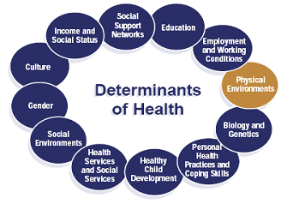
Notes:
The Social Determinants of Health are conditions that influence the health of people and communities.
They are upheld by the World Health Organization.
Some we cannot affect (like biology and genetics), but others we can, such as physical environments which we will be talking about today.

Slide 3
How to be a good roommate?
Communication
Cleaning guidelines
Privacy & Habits
Notes:
*highlight of the points discussed throughout the presentation*

Slide 4
Communication
Set your ground rules
Listen to your roommates requests
Express your concerns before they become problems
Consider the agreed-upon guidelines on your day-to-day activities
Notes:
*give personal examples of ground rules*

Slide 5
Cleaning Guidelines
Create a cleaning schedule
  It helps, a lot!!!
Kitchen Rules:
  Wash dishes right after you use them
  Clean and disinfect the sink at least once a week
  Replace your sponge or disinfect it as often as possible
  Do NOT throw grease/leftovers down the drain
  Clean countertops and the stove after you finish cooking
  Do NOT let the garbage can overflow!!!
A not-so-fun fact: Your kitchen sink has the most germs in the entire house!
Notes:
*stress the importance of washing dishes right after you use them*

Slide 6
Cleaning guidelines
Food storing
  Divide the shelf / fridge space in advance to avoid confusion and conflict
  Don't crowd the refrigerator or freezer so tightly that air can't circulate
  Store meats in temperatures of 4°C or lower
  Ensure packaging is intact, no tears, moisture, etc. on dry foods
  Canned foods: ensure cans and seals are in good condition
Notes:
While cold temperatures don’t kill bacteria, it does stop them from growing
Can damage is shown by swelling, leakage, punctures, holes, fractures, extensive deep rusting, or crushing or denting
Damaged packaging means safety may be compromised

Slide 7
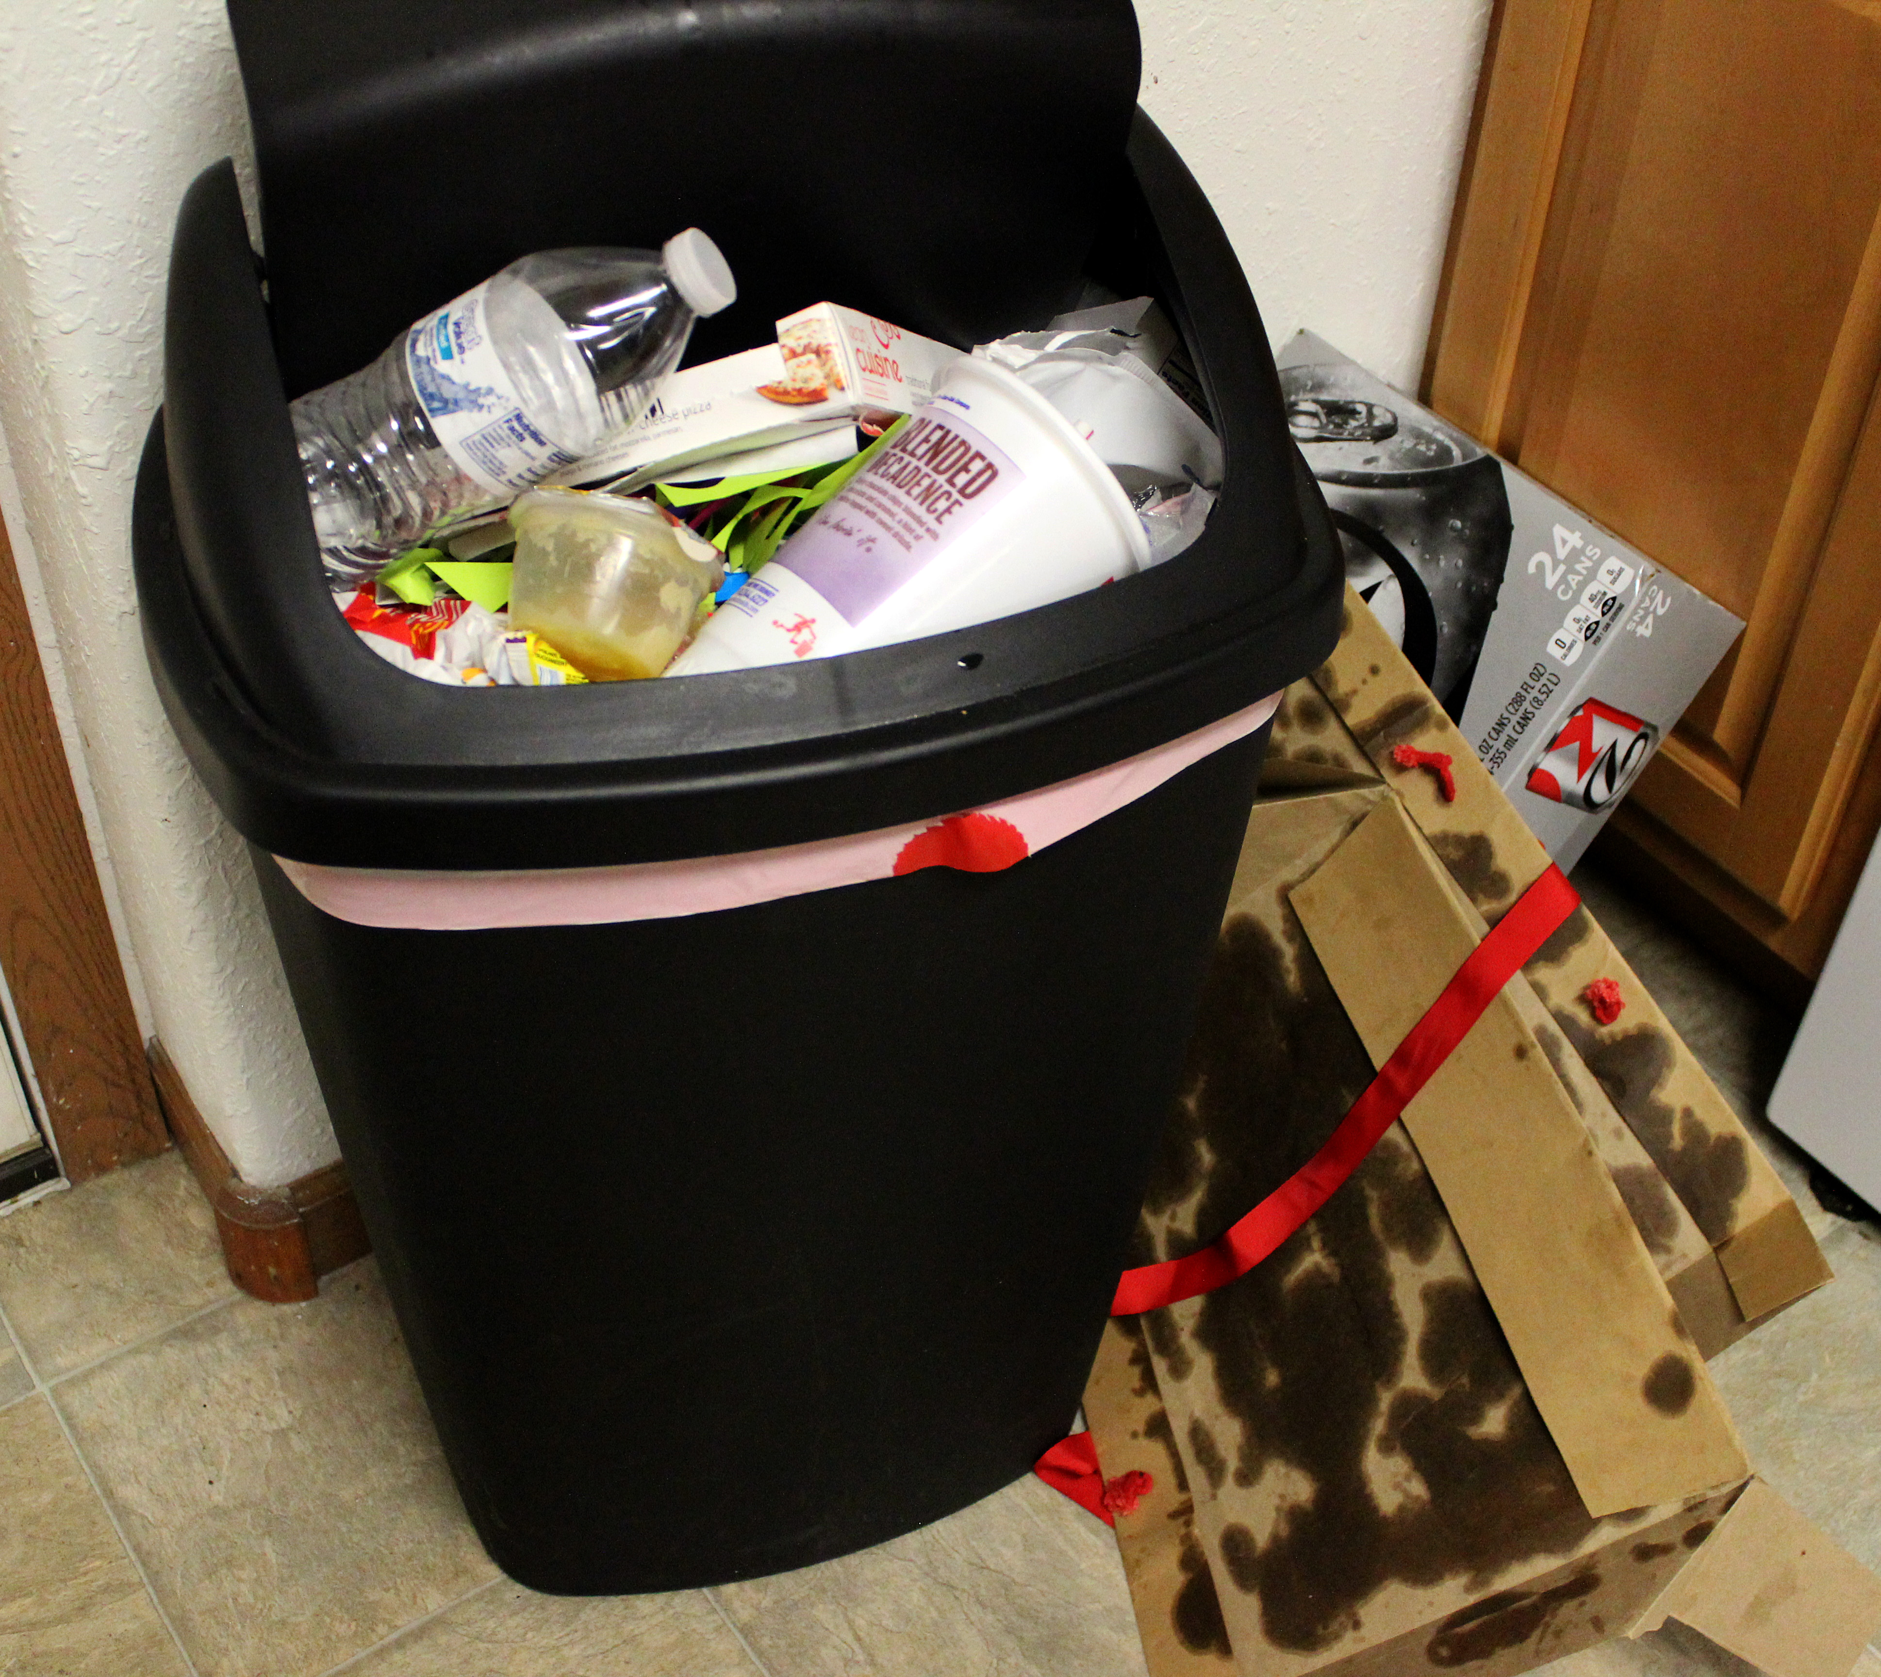
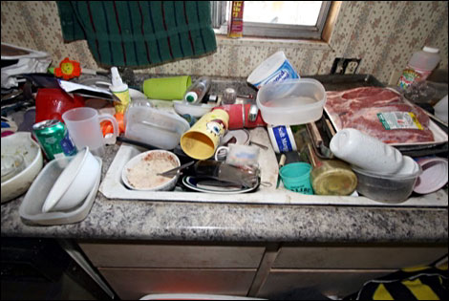
Here’s how your house should not look like

Slide 8
Cleaning Guidelines
Bathroom rules
  Use personal towels
  Separate toiletries (ex. Don’t use your roommate’s toothbrush)
  Scrub the sink once per week
  Clean the tub and shower. Spray with cleaner and scrub the walls
  Disinfect the toilet once per week
  Clean the wastebasket regularly, as needed
Notes:
Use separate towels and toiletries to reduce the spread of germs

Slide 9
Why clean?
If you don’t clean properly there is a potential for infestation
House mice are gray or brown rodents with relatively large ears and small eyes
When a mouse infestation already exists, some form of population reduction is almost always necessary
Good sanitation will reduce food and shelter for existing mice and in turn make baits and traps more effective

Slide 10
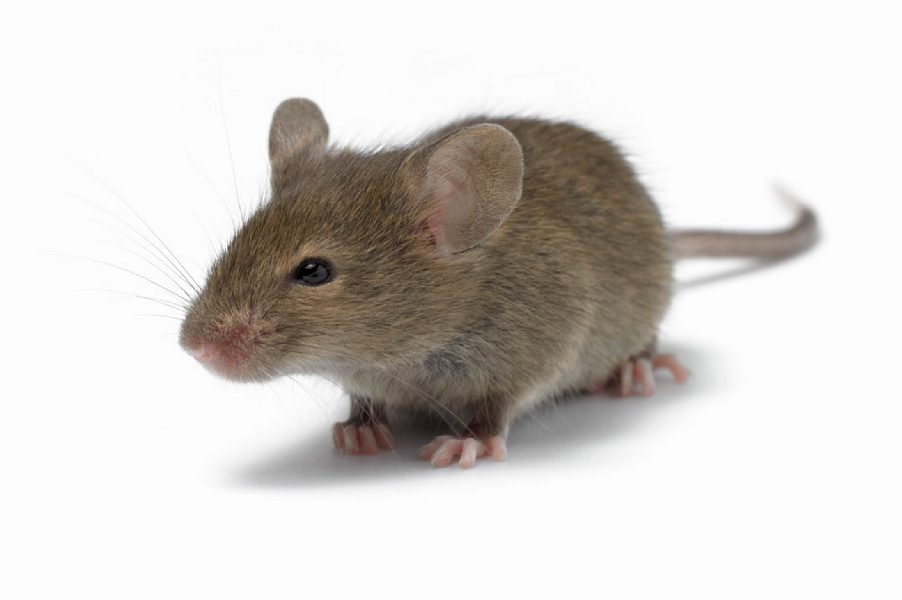
Notes:
Although somewhat cute looking, they can pose a risk to your health

Slide 11
Health Risks Associated with Mice Infestation
Mice are carriers of bacteria, diseases, parasites, and viruses
Mice can chew through electrical wires, causing a fire
Notes:
According to the Centers for Disease Control and Prevention (CDC), humans can contract Lymphocytic Choriomeningitis from breathing in dust that has been polluted with mouse droppings and urine
Fires effect many social determinants of health such as physical environments, income, and personal coping mechanisms

Slide 12
Controlling mice
Trapping is an effective control method. When only a few mice are present in a building, it is usually the preferred control method.
Poison Baits/ Rodenticides are poisons that kill rodents. They can be purchased in hardware stores, feed stores, discount stores, garden centers and other places where pesticides are sold

Slide 13
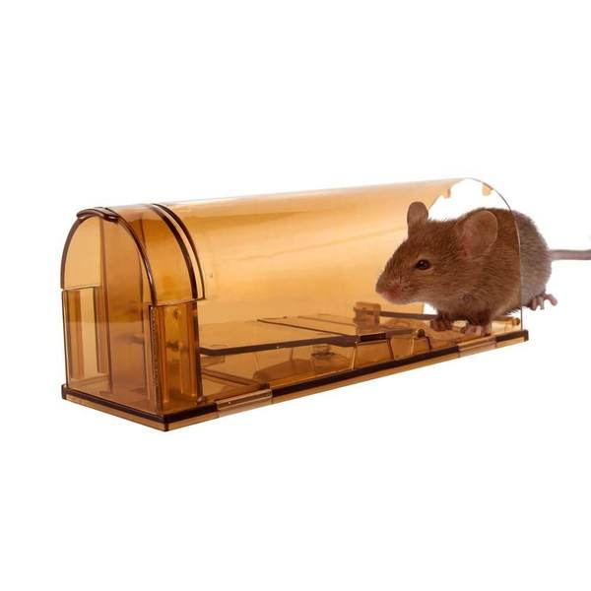

Slide 14
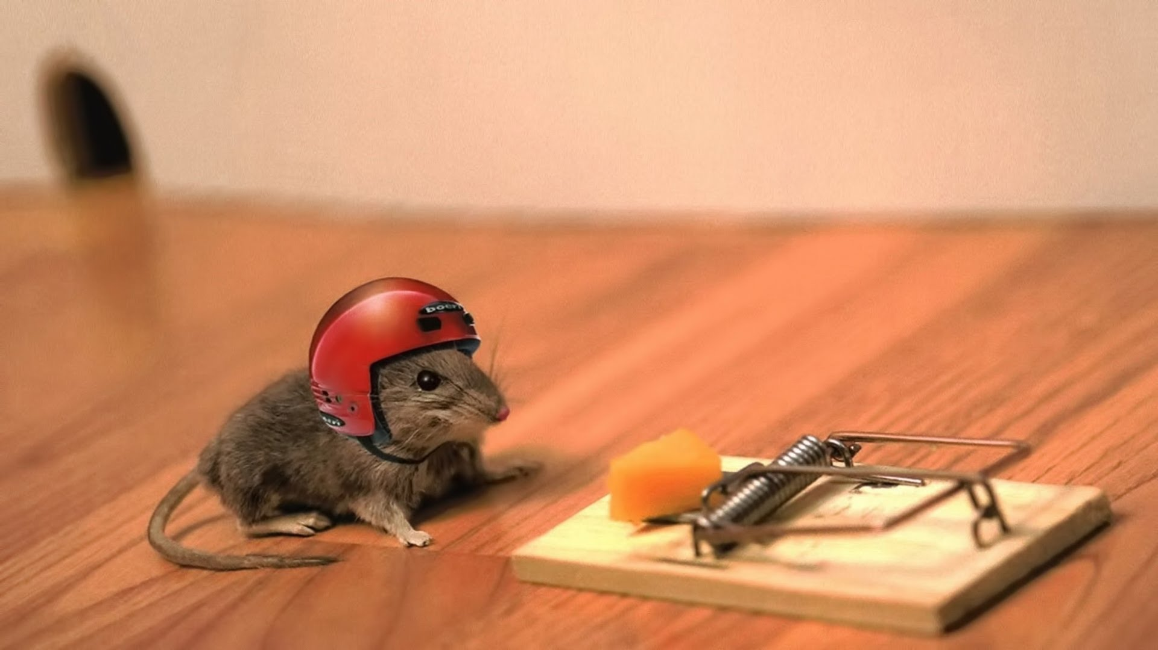

Slide 15
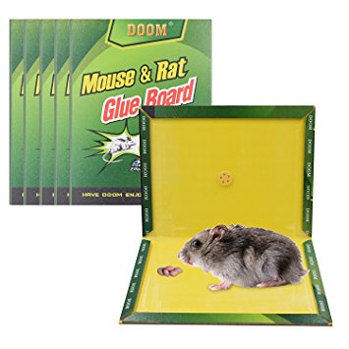

Slide 16
Why clean?
Bed bugs: are small, oval, brownish insects that live on the blood of animals or humans
May enter your home undetected through luggage, clothing, used beds and couches, and other items
They are active mainly at night and usually bite people while they are sleeping. They feed by piercing the skin and withdrawing blood through an elongated beak
Notes:
When buying used furniture, make sure to inspect it and ASK

Slide 17
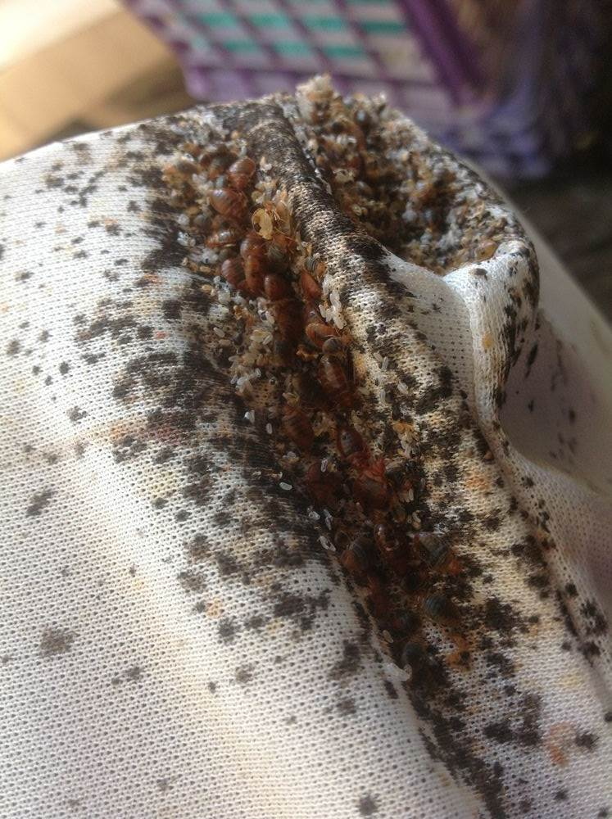
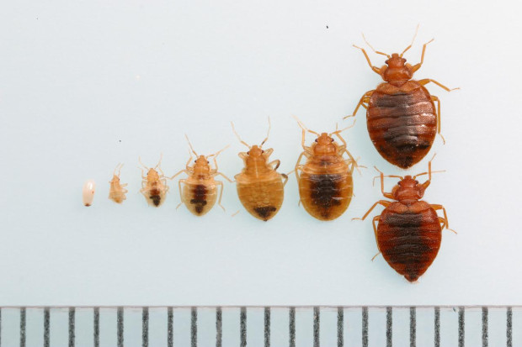
Why clean?
Notes:
Bedbugs are very small ranging from 1.5 to 10 mm in size. They have flat, oval bodies, are brown in colour, and have no wings. Their eggs are white and about 1 mm long which are hard to see. Bedbugs feed on the blood of people and animals, but can live without food for up to a year and a half. They often bite at night and can bite anywhere on the body. Bedbugs will turn a dark red colour and have a bloated body after feeding.

Slide 18
Can you get sick from them?
Although bedbugs bite, they have not been linked to the spread of disease
Bedbugs bite marks can take up to 14 days to appear
They can cause swelling, redness, and itching which can lead to skin infections
In rare cases, some people may have severe allergic reactions
Bedbug infestation can also lead to a loss of sleep, stress, anxiety, depression, and fatigue
Notes:
The best way to treat a bite is to avoid scratching the area, keep the skin clean, and apply antiseptic creams or lotions. If the bites are very itchy or get infected, see your health care provider.

Slide 19
Bed Bug Removal
Health Canada recommends hiring a licensed professional pest control operator to remove bedbugs
If you are a tenant and have bedbugs, you should talk to your landlord
Our Windsor Health Unit does not investigate bedbug complaints, as it is not a health hazard. They do provide education and resources on bedbugs

Slide 20
Treating Bed Bugs
Anything removed from the room should be placed in a sealed plastic bag and treated
Empty the vacuum after each use
Don't discard furniture if you can eliminate the bed bugs from it
If furniture cannot be salvaged, discard it responsibly
Notes:
Wash items in hot water and put in hot dryer
Steam clean non washable items
Throw out items that can’t be washed, heated, or steam cleaned
Vacuum using a stiff brush attachment

Slide 21
Privacy & Habits
Be aware of your roommates privacy
  Don’t use their electronics without permission
  Don’t wear their clothes without asking
  Don’t take food from their cabinets without asking
Discuss a guest policy
Notice your roommates sleeping and studying habits and respect them
Notes:
*emphasize communication*

